Slide 1
Voice User Interfaces
Involves a person talking with a spoken language app, for example, timetable, travel planner, or phone service
Used most for inquiring about specific information, for example, flight times or to perform a transaction, such as buying a ticket
Also used by people with visual impairments
For example, speech recognition word processors, page scanners, web readers, and home control systems
Notes:
1

Slide 2
Have speech interfaces come of age?
Notes:
2

Slide 3
Modeling human conversations
People often interrupt each other in a conversation
Especially when ordering in a restaurant, rather than let the waiter go through all of the options
Speech technology has a similar feature called ‘barge-in’
Users can choose an option before the system has finished listing all of the options available

Slide 4
Structuring VUI dialogs
Directed dialogs are where the system is in control of the conversation
Where it asks specific questions and requires specific responses
More flexible systems allow the user to take the initiative:
For example, “I’d like to go to Paris next Monday for two weeks.”
But more chance of error, since caller might assume that the system is like a human
Guided prompts can help callers back on track
For example, “Sorry I did not get all that. Did you say you wanted to fly next Monday?”
Notes:
4

Slide 5
Voice assistants (for example, Alexa)
Have become popular in many homes
Allow all to use rather than being single use
Support families playing games, interactive storytelling, jokes, and so forth
Can encourage social and emotional bonding
Young children (under 4), however, find it difficult to be understood by the voice assistants
Frustrating for them

Slide 6
Research and design considerations
How to design systems that can keep conversation on track
Help people navigate efficiently through a menu system
Enable them to recover easily from errors
Guide those who are vague or ambiguous in their requests for information or services
Type of voice actor (for example, male, female, neutral, or dialect)
Do people prefer to listen to and are more patient with a female or male voice, a northern or southern accent?
Notes:
6

Slide 7
Pen-based devices
Enable people to write, draw, select, and move objects at an interface using light pens or styluses
Capitalize on the well-honed drawing skills developed from childhood
Digital ink, for example, Anoto, use a combination of ordinary ink pen with digital camera that digitally records everything written with the pen on special paper

Slide 8
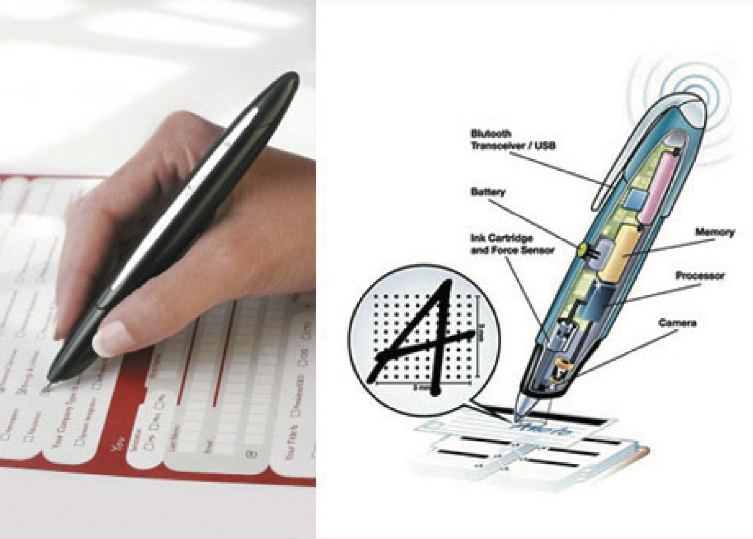
The Anoto pen being used and its internal components

Slide 9
Advantages
Allows users to annotate existing documents quickly and easily
Can be used to fill in paper-based forms that can readily be converted to a digital record using standard typeface
Can be used by remote teams to communicate and work on the same documents

Slide 10
Touchscreens
Single touchscreens are used in walk-up kiosks (such as ticket machines and ATMs) to detect the presence and location of a person’s touch on the display
Multi-touch surfaces support a range of more dynamic finger tip actions, for example, swiping, flicking, pinching, pushing, and tapping
They do so by registering touches at multiple locations using a grid
Now used for many kinds of displays, such as smartphones, iPods, tablets, and tabletops
Supports one and two hand gestures, including tapping, zooming, stretching, flicking, dwelling, and dragging
Notes:
10

Slide 11
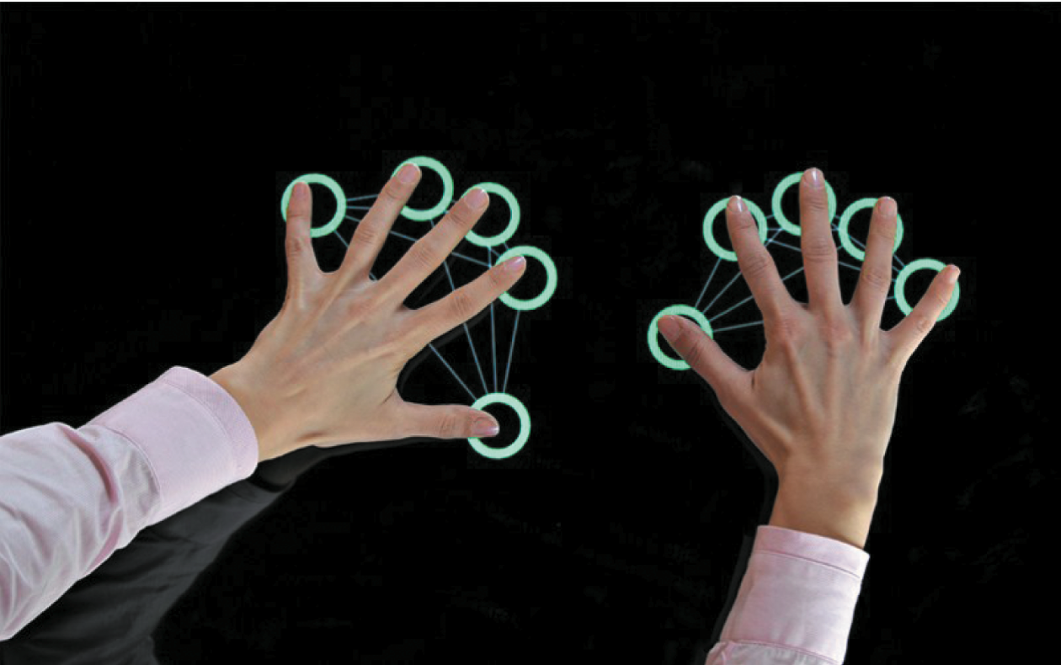
A multi-touch surface

Slide 12
Research and design considerations
Provides fluid and direct styles of interaction involving freehand and pen-based gestures for certain tasks
Core design concerns include whether size, orientation, and shape of touch displays effect collaboration
Much faster to scroll through wheels, carousels, and bars of thumbnail images or lists of options by finger flicking
Gestures need to be learned for multi-touch, so a small set of gestures for common commands is preferable
More cumbersome, error-prone, and slower to type using a virtual keyboard on a touch display than using a physical keyboard
Notes:
12

Slide 13
Gesture-based systems
Gestures involve moving arms and hands to communicate
Uses camera recognition, sensor, and computer vision techniques
Recognize people’s arm and hand gestures in a room
Gestures need to be presented sequentially to be understood (compare with the way sentences are constructed)

Slide 14
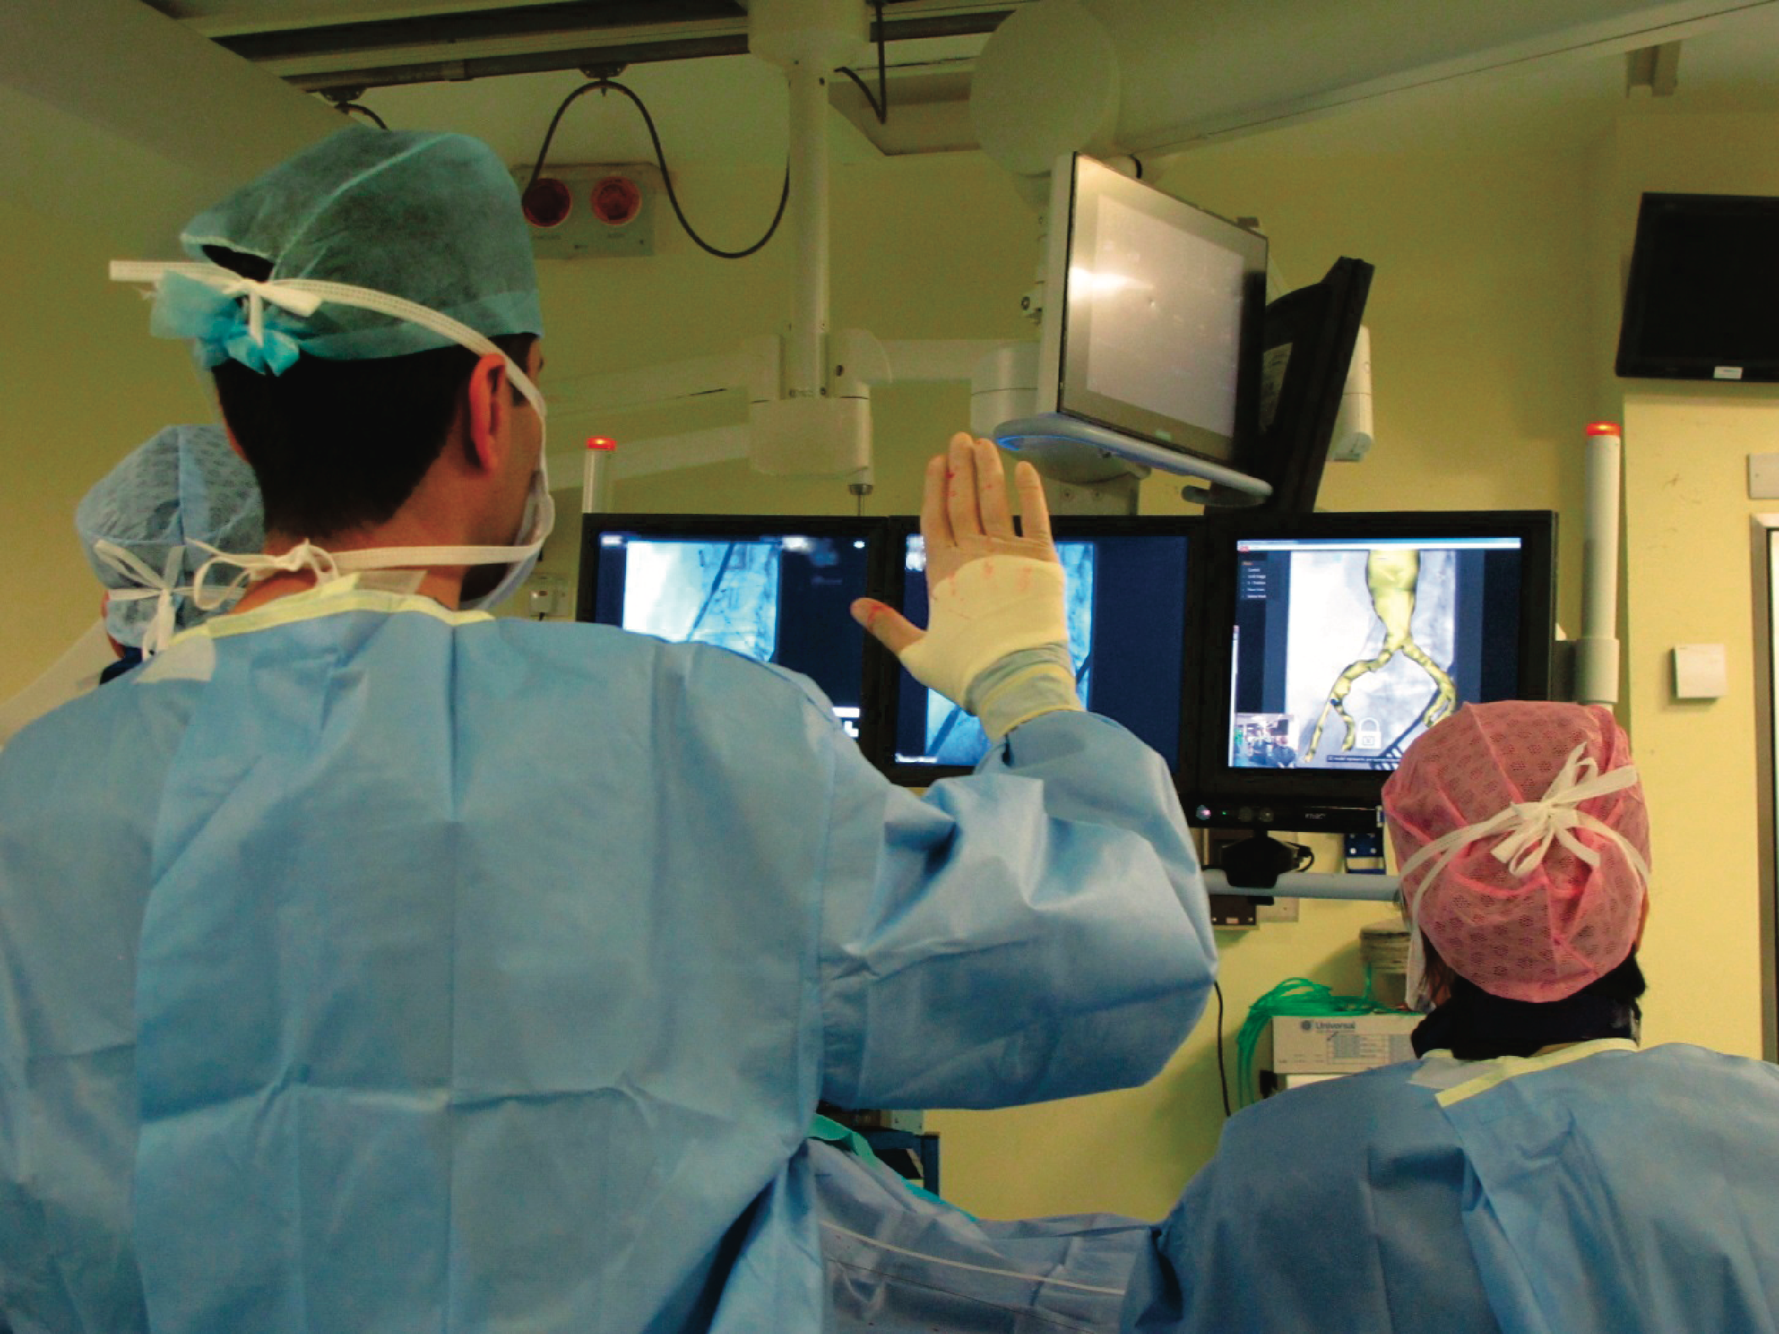
Gestures used in the operating theater
Recognizes core gestures for manipulating MRI or CT images using Microsoft Kinect

Slide 15
Research and design considerations
How does computer recognize and delineate user’s gestures?
Start and end points?
Difference between deictic and hand waving
How realistic must the mirrored graphical representation of the user be in order for them to be believable?
Notes:
A key design concern for using air-based gestural input is to consider how a computer system recognizes and delineates the user’s gestures. In particular, how does it determine the start and end point of a hand or arm movement and how does it know the difference between a deictic gesture (a deliberate pointing movement) and hand waving (an unconscious gesticulation) that is used to emphasize what is being said verbally? Another key design issue is whether holding a control device feels more intuitive for the game or other activity than controller free gestures. Sometimes it clearly is better to be holding something – when for example, hitting a ball with a bat. Other times it may be better hands-free such as when dancing or doing aerobics.
15

Slide 16
Haptic interfaces
Provide tactile feedback
By applying vibration and forces to a person’s body, using actuators that are embedded in their clothing or a device they are carrying, such as a smartphone
Vibrotactile feedback can be used to simulate the sense of touch between remote people who want to communicate
Ultrahaptics creates the illusion of touch in midair using ultrasound to make the illusion of 3D shapes

Slide 17
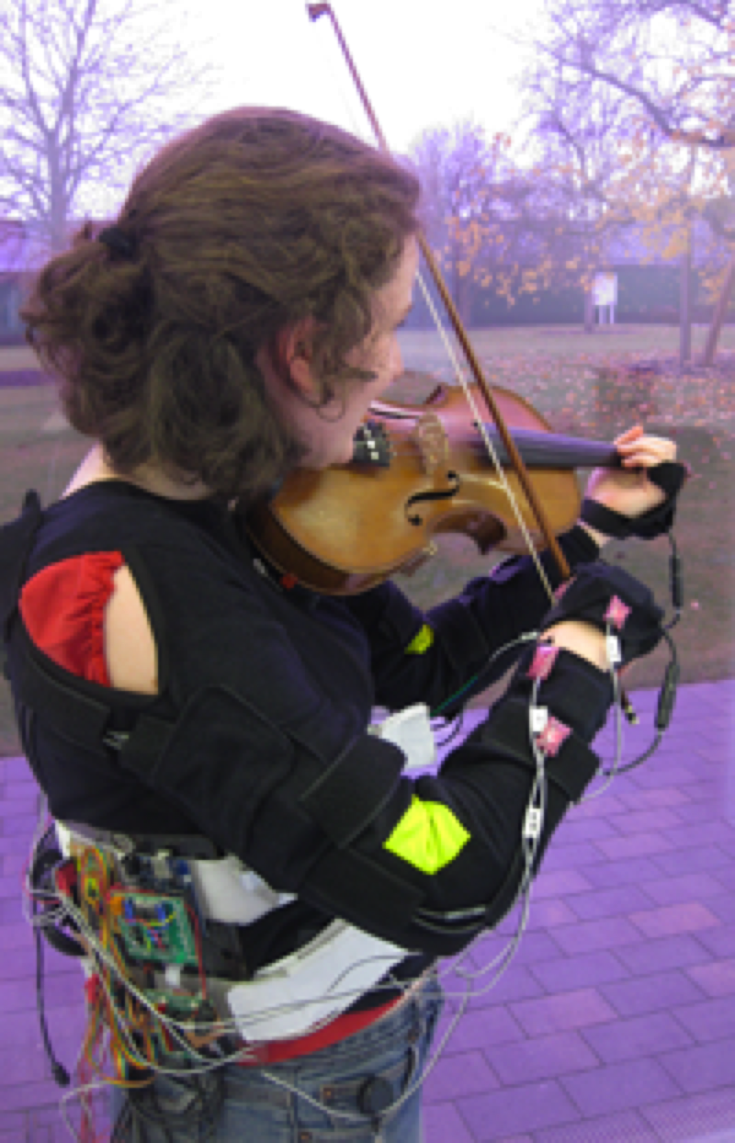
Realtime vibrotactile feedback
Provides nudges when playing violin incorrectly
Uses motion capture to sense arm movements that deviate from model
Nudges are short vibrations on arms and hands

Slide 18
Exoskeleton with artificial muscles that uses bubble haptic feedback

Slide 19
Research and design considerations
Where best to place actuators on body
Whether to use single or sequence of ‘touches’
When to buzz and how intense
How does the wearer feel it in different contexts?
What kind of new smartphone/smartwatch apps can use vibrotactile creatively?
For example, slow tapping to feel like water drops meant to indicate that it is about to rain, and heavy tapping to indicate a thunderstorm is looming
Notes:
19

Slide 20
Multimodal Interfaces
Provide enriched user experiences
By multiplying how information is experienced and detected using different modalities, such as touch, sight, sound, and speech
Support more flexible, efficient, and expressive means of human-computer interaction
Most common is speech and vision
Can be combined with multi-sensor input to enable other aspects of the human body to be tracked
For example, eye gaze, facial expression, and lip movements
Provides input for customizing user interfaces

Slide 21
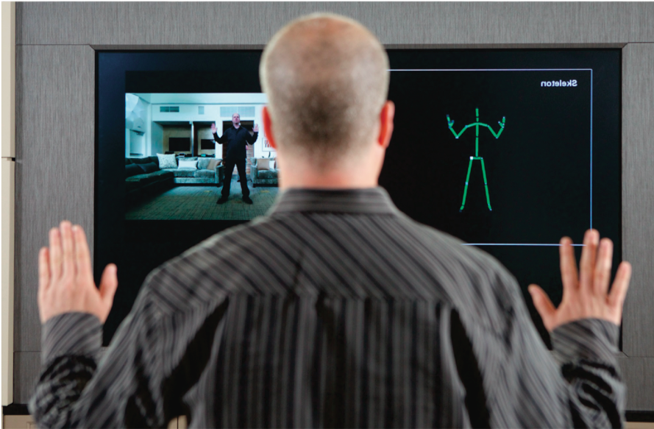
Tracking a person’s movements
Kinect camera can detect multimodal input in real time using RGA camera for facial recognition and gestures, depth camera for movement tracking, and microphones for voice recognition
Used to build model of person and represented as avatar on display programmed to move just like them

Slide 22
Research and design considerations
Need to recognize and analyze user behavior, for example, speech, gesture, handwriting, or eye gaze
Much harder to calibrate these than single modality systems
What is gained from combining different input and outputs
Is talking and gesturing, as humans do with other humans, a natural way of interacting with a computer?

Slide 23
Shareable interfaces
Designed for more than one person to use:
Provide multiple inputs and sometimes allow simultaneous input by co-located groups
Large wall displays where people use their own pens or gestures
Interactive tabletops where small groups interact with information using their fingertips
For example, DiamondTouch, Smart Table, and Surface
Notes:
23

Slide 24
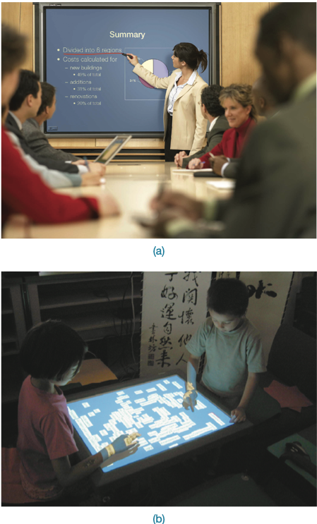
A smartboard and an interactive tabletop interface
Notes:
24

Slide 25
Benefits
Provide a large interactional space that can support flexible group working
Can be used by multiple users
Can point to and touch information being displayed
Simultaneously view the interactions and have the same shared point of reference as others
Can support more equitable participation compared with groups using single PC
Notes:
25

Slide 26
Research and design considerations
Core design concerns include whether size, orientation, and shape of the display have an effect on collaboration
Horizontal surfaces compared with vertical ones support more turn-taking and collaborative working in co-located groups
Providing larger-sized tabletops does not improve group working but encourages more division of labor
Having both personal and shared spaces enables groups to work on their own and in a group
Cross-device systems have been developed to support seamless switching between these, for example, SurfaceConstellations
Notes:
26

Slide 27
Tangible Interfaces
Type of sensor-based interaction, where physical objects, for example, bricks, are coupled with digital representations
When a person manipulates the physical object/s, it causes a digital effect to occur, for example, an animation
Digital effects can take place in a number of media and places, or they can be embedded in the physical object
Notes:
27

Slide 28
Examples
Flow Blocks
Depict changing numbers and lights embedded in the blocks
Vary depending on how they are connected together
Urp
Physical models of buildings moved around on tabletop
Used in combination with tokens for wind and shadows
Digital shadows surrounding them to change over time
MagicCubes
Connect physical electronic components and sensors to make digital events occur (for example, change color depending on how much shaken)
Notes:
28

Slide 29
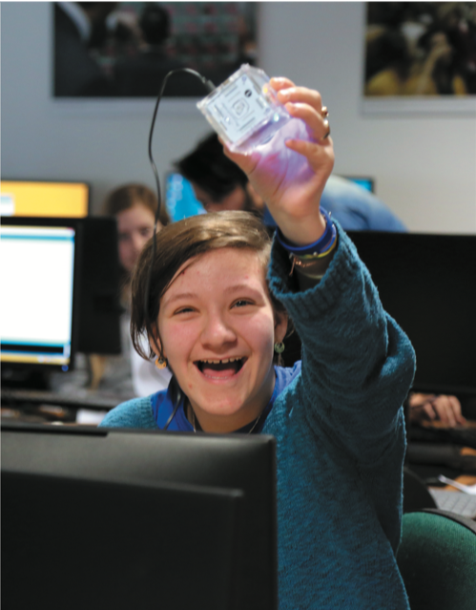
Learning to code and create with the tangible MagicCubes

Slide 30
Benefits
Can be held in one or both hands and combined and manipulated in ways not possible using other interfaces
Allows for more than one person to explore the interface together
Objects can be placed on top of each other, beside each other, and inside each other
Encourages different ways of representing and exploring a problem space
People are able to see and understand situations differently
Can lead to greater insight, learning, and problem-solving than with other kinds of interfaces
Can facilitate creativity and reflection
Notes:
30

Slide 31
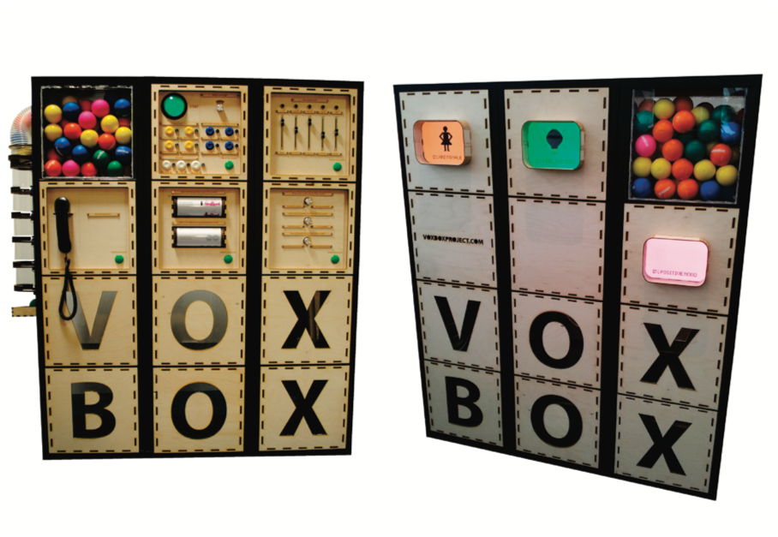
VoxBox
A tangible system that gathers opinions at events through playful and engaging interaction (Goldsteijn et al., 2015)
Notes:
31

Slide 32
Research and design considerations
What kinds of conceptual frameworks to use to help identify novel and specific features
What kind of coupling to use between the physical action and digital effect
If it is to support learning, then an explicit mapping between action and effect is critical
If it is for entertainment, then it can be better to design it to be more implicit and unexpected
What kind of physical artifact to use
Bricks, cubes, and other component sets are most commonly used because of flexibility and simplicity
Stickies and cardboard tokens can also be used for placing material onto a surface
With what kinds of digital outputs should tangible interfaces be combined?
Notes:
32

Slide 33
Augmented Reality
Augmented reality: Virtual representations are superimposed on physical devices and objects
Pokémon Go made it a household game
Used smartphone camera and GPS to place virtual characters onto objects in the environment as if they really are there
Many other applications including medicine, navigation, air traffic control, games, and everyday exploring

Slide 34
Other examples
In medicine
Virtual objects, for example, x-rays and scans, are overlaid on part of a patient’s body
Aid the physician’s understanding of what is being examined or operated
In air traffic control
Dynamic information about aircraft overlaid on a video screen showing the real planes, and so on landing, taking off, and taxiing
Helps identify planes difficult to make out

Slide 35
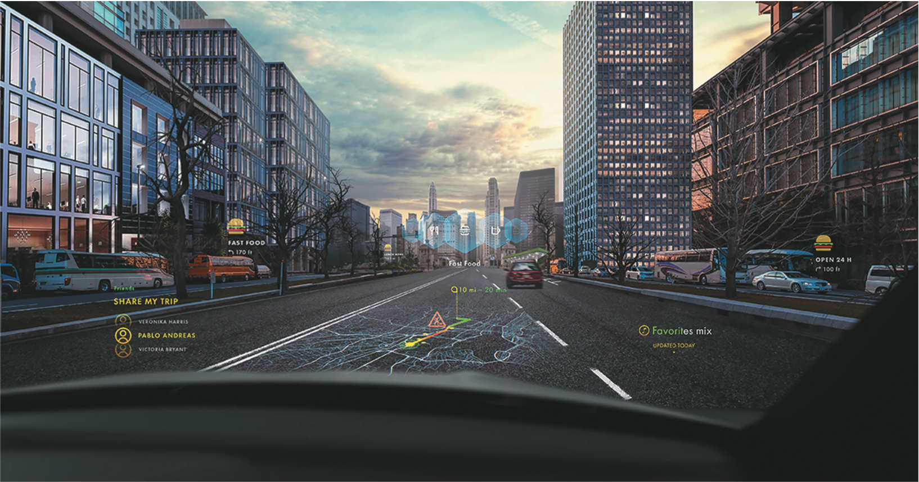
Augmented reality overlay on a car windshield

Slide 36
AR that uses forward facing camera
Enables virtual try-ons (for example, Snapchat filters)
AT mirrors set up in retail stores for trying on make-up, sunglasses, jewelry
Convenient, engaging, and easy to compare more choices
But cannot feel the weight, texture, or smell of what is being tried on
Can be used to enable users to step into a character (for example, David Bowie, Queen Victoria)

Slide 37
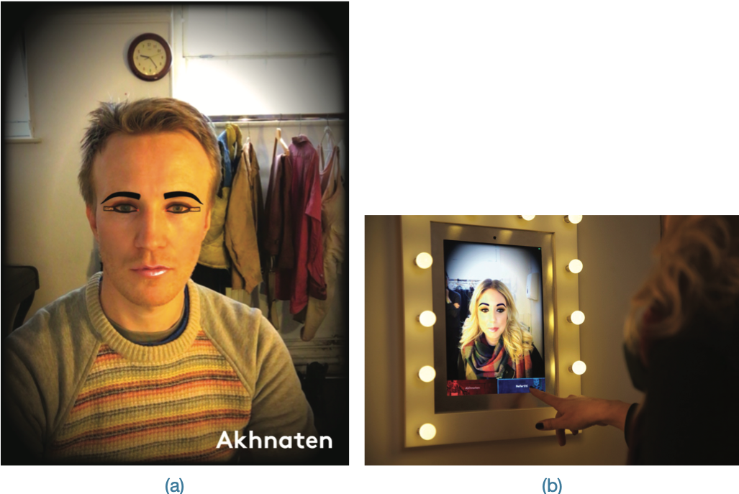
Singers trying on the virtual look of two characters from the opera Akhnaten

Slide 38
Research and design considerations
What kind of digital augmentation?
When and where in physical environment?
Needs to stand out but not distract from ongoing task
Needs to be able to align with real world objects
What happens if the AR is slightly off?
What kind of device?
Smartphone, tablet, head up display or other?
Notes:
38

Slide 39
Wearables
First developments were head- and eyewear-mounted cameras that enabled user to record what was seen and to access digital information
Since then, jewelry, head-mounted caps, smart fabrics, glasses, shoes, and jackets have all been used
Provides the user with a means of interacting with digital information while on the move
Applications include automatic diaries, tour guides, cycle indicators, and fashion clothing
Notes:
39

Slide 40
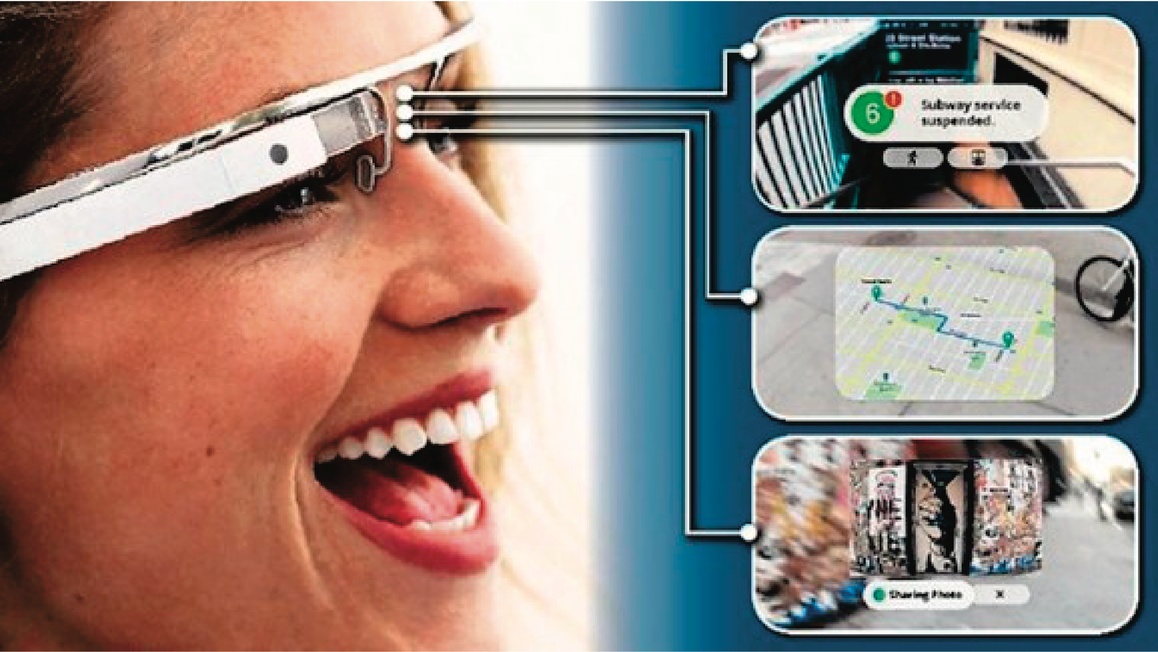
Google Glass (2014)
Why was there so much excitement and concern about people filming what they could see right in front of them?
Notes:
Google glass was designed to look like a pair of glasses, but with one lens of the glass being an interactive display with an embedded camera, that can be controlled with speech input. It allows the wearer to take photos and video on the move and look at digital content, such as emails, texts, and maps. The wearer can also search the web using voice commands and the results come back on the screen. A number of applications have been developed besides everyday use, including WatchMeTalk that provides live captions that helps the hearing-impaired in their day-to-day conversations and Preview for Glass that enables a wearer to watch a movie trailer the moment they look at a movie poster.
It stopped being sold at the end of 2014. It was considered slightly unnerving when in the company of someone wearing Google Glass as they look up and to the right to view what is on the glass screen rather than at you and into your eyes. As a result you might see more of the whites of their eyes than the usual interested dilated pupils. Could this be the end of eye contact as we know it? One of the criticisms of early wearers of Google Glass was that it made them appear to be staring into the distance.
Others are worried that those wearing Google Glass are recording everything that is happening in front of them. As a reaction a number of bars and restaurants in San Francisco and other cities have implemented a “no Glass” policy to prevent customers from recording other patrons. There has also been much debate in the press about the latest developments in facial recognition. There are apps developed for Google Glass that take a picture of the person you are talking with and then check their online profile, providing a cloud of personal information about them, presumably mined from Facebook and other social media apps. So, you can find out more about someone on the go while talking to them – for example, what music they like, what films they have just seen, where they have just been on vacation, and so on – all in a digestible précis surrounded by a halo of photos. One could imagine that if this way of meeting up with others actually takes off, we might find ourselves in the situation where we won’t need to talk to each other anymore. Just as text messaging has largely taken over from making phone calls for many people, ‘cloud talk’ could start taking over our initial encounters with people when we meet them at parties, at conferences, on trains etc. We might nod and smile in acknowledgement of each other but we won’t ever have to have those awkward conversations anymore, such as about where you come from or what you do for work. A panacea for the shy? But how will we know what each other is looking at? You might think I am reading your blog or tweets when in your presence but really I might just be watching the latest updates of the football results and pretending to ‘meet you’.

Slide 41
Research and design considerations
Comfort
Needs to be light, small, not get in the way, fashionable, and preferably hidden in the clothing
Hygiene
Is it possible to wash or clean the clothing once worn?
Ease of wear
How easy is it to remove the electronic gadgetry and replace it?
Usability
How does the user control the devices that are embedded in the clothing?
Notes:
41

Slide 42
Robots
Main types
Remote robots used in hazardous settings
Can be controlled to investigate bombs and other dangerous materials
Domestic robots helping around the house
Can pick up objects and do daily chores like vacuuming
Pet robots as human companions
Have therapeutic qualities, helping to reduce stress and loneliness
Sociable robots that work collaboratively with humans
Encourage social behaviors
Notes:
42

Slide 43
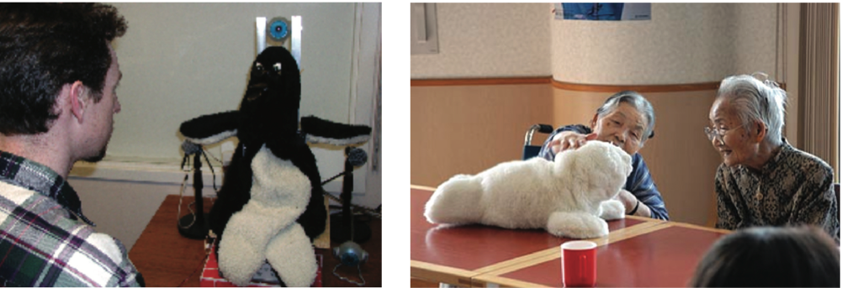
Social robots: Mel and Paro
Cute and cuddly
Can open and close eyes and make sounds and movements
Source: Images courtesy of Mitsubishi Electric Research Labs.
Notes:
43

Slide 44
Drones
Unmanned aircraft that are controlled remotely and used in a number of contexts
For example, entertainment, such as carrying drinks and food to people at festivals and parties
Agricultural applications, such as flying them over vineyards and fields to collect data about crops, which is useful to farmers
Helping to track poachers in wildlife parks in Africa
Can fly low and and stream photos to a ground station where images can be stitched together into maps
Can be used to determine the health of a crop, or when it is the best time to harvest the crop

Slide 45
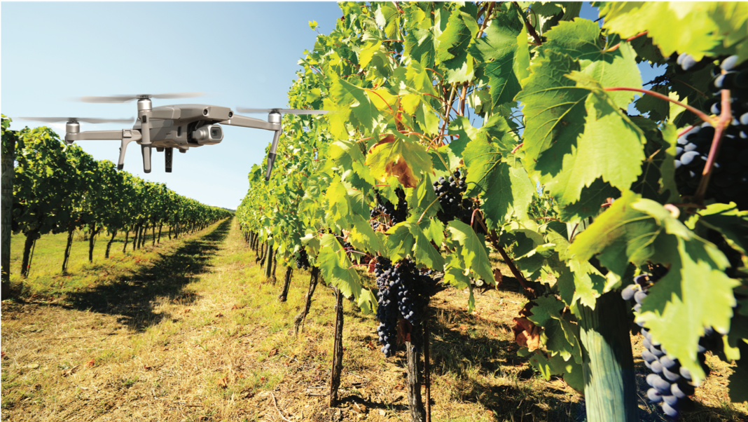
Drone being used to survey the state of a vineyard

Slide 46
Research and design considerations
How do humans react to physical robots designed to exhibit behaviors (for example, making facial expressions) compared with virtual ones?
Should robots be designed to be human-like or look like and behave like robots that serve a clearly-defined purpose?
Should the interaction be designed to enable people to interact with the robot as if it was another human being or more human-computer-like (for example, pressing buttons to issue commands)?
Is it acceptable to use unmanned drones to take a series of images or videos of fields, towns, and private property without permission or people knowing what is happening?
Notes:
46

Slide 47
Brain-computer interfaces
Brain-computer interfaces (BCI) provide a communication pathway between a person’s brain waves and an external device, such as a cursor on a screen
Person is trained to concentrate on the task, for example, moving the cursor
BCIs work through detecting changes in the neural functioning in the brain
BCIs apps:
Games (for example, Brain Ball)
Enable people who are paralyzed to control robots

Slide 48
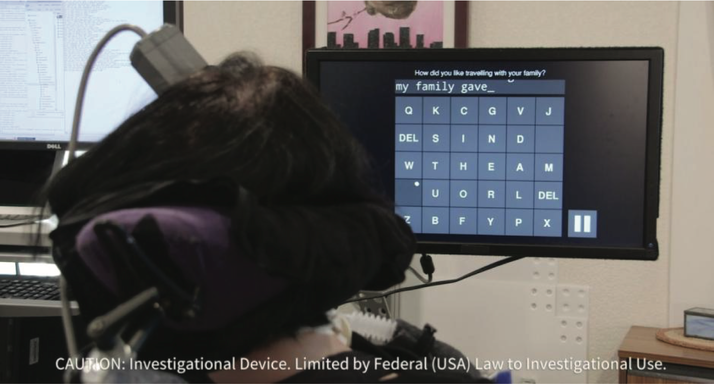
A brain-computer interface being used by a woman who is paralyzed to select letters on the screen

Slide 49
Smart interfaces
Smart: phones, speakers, watches, cars, buildings, cites
Smart refers to having some intelligence and connected to the internet and other devices
Context-aware
Understand what is happening around them and execute appropriate actions, for example, a Nest thermostat
Human-building interaction
Buildings are designed to sense and act on behalf of the inhabitants but also allow them to have some control and interaction with the automated systems

Slide 50
Which interface?
Which interface to use will depend on task, users, context, cost, robustness, and so on
Is multimedia better than tangible interfaces for learning?
Is speech as effective as a command-based interface?
Is a multimodal interface more effective than a mono-modal interface?
Will wearable interfaces be better than mobile interfaces for helping people to find information in foreign cities?
Are virtual environments the ultimate interface for playing games?
Are shareable interfaces better at supporting communication and collaboration compared with using networked desktop PCs?
Notes:
50

Slide 51
Summary
Many innovative interfaces have emerged in last 30 years, including speech, wearable, mobile, brain, and tangible
This raises many design and research questions as to decide which to use
For example, how best to represent information to the user so that they can carry out ongoing activity or task
New smart interfaces that are context-aware and monitor people
Raising new ethical issues concerned with what data is being collected and what it is used for
Notes:
51

